Slide 1
Introduction to Cloud Computing
Notes:
https://learn.microsoft.com/training/paths/microsoft-azure-fundamentals-describe-cloud-concepts/
https://learn.microsoft.com/training/modules/create-an-azure-account/
https://learn.microsoft.com/training/modules/describe-core-architectural-components-of-azure/4-exercise-explore-learn-sandbox

Slide 2

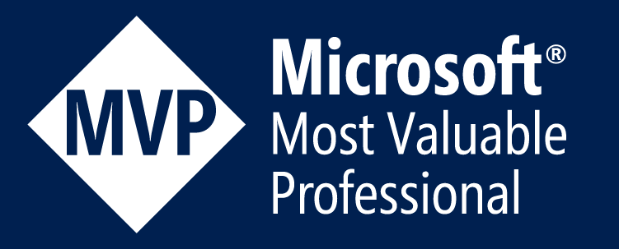
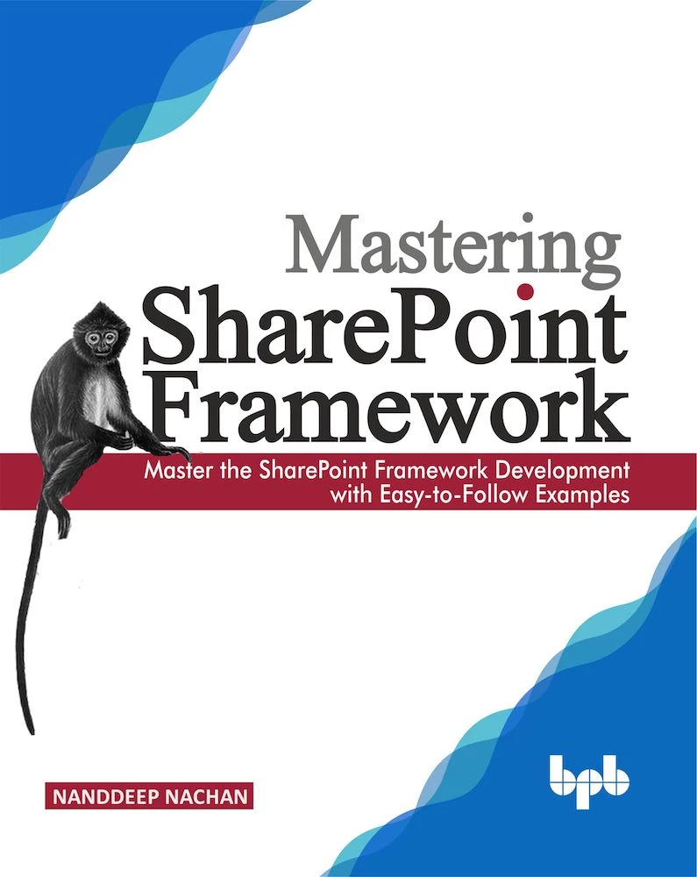
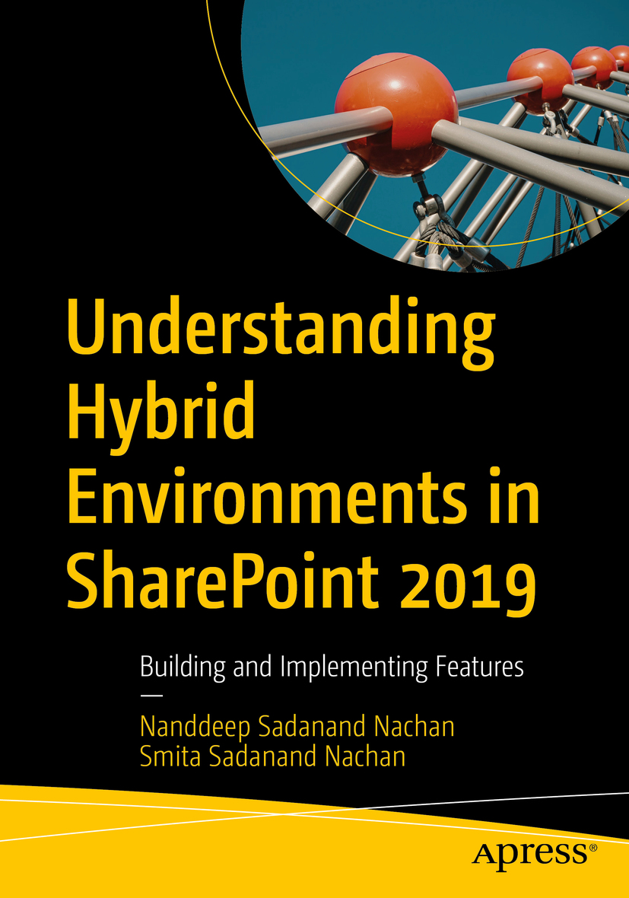
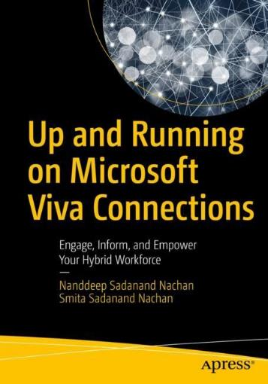
Nanddeep Nachan
M365 Consultant
Speaker | Author | Blogger
Speaker Bio
Pune, India
Twitter Handle: @NanddeepNachan
LinkedIn: /in/NanddeepNachan
https://nanddeepnachanblogs.com
https://www.youtube.com/c/NanddeepNachan
Microsoft 365, Power Platform, Microsoft Azure

Slide 3

Learning path 01―outline
You will learn the following concepts:
1
Cloud computing
What is cloud computing
Shared responsibility
Cloud models
Capital vs operational costing
2
Cloud benefits
Benefits of the cloud
3
Cloud service types
IaaS, PaaS, and SaaS

Slide 4
Cloud computing
Notes:
https://learn.microsoft.com/training/modules/describe-cloud-compute/

Slide 5
Cloud computing―objective domain
Define cloud computing.
Define cloud models, including public, private, and hybrid.
Identify appropriate use cases for each cloud model.
Describe the consumption-based model.
Compare cloud pricing models.
Notes:
https://learn.microsoft.com/training/modules/describe-cloud-compute/2-introduction-cloud-compute

Slide 6
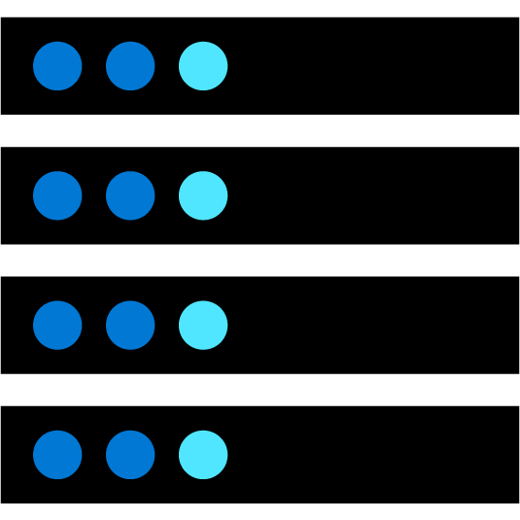


What is cloud computing?
Cloud computing is the delivery of computing services over the internet, enabling faster innovation, flexible resources, and economies of scale.
Compute
Networking
Storage
Notes:
https://learn.microsoft.com/training/modules/describe-cloud-compute/3-what-cloud-compute
Cloud computing is:
A model for enabling on-demand access to a shared pool of configurable computing resources―servers, network, storage, applications, and services.
Ubiquitous, convenient, on-demand network access.
Rapidly provisioned and released with minimal management effort or service provider interaction.
Definitions can be found at:
NIST definition - https://csrc.nist.gov/publications/detail/sp/800-145/final

Slide 7
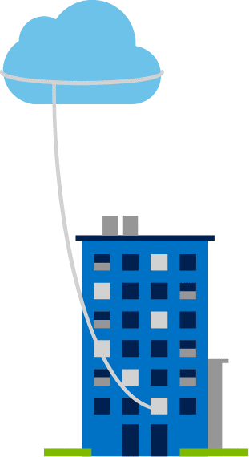
Private cloud
Organizations create a cloud environment in their datacenter.
Organizations are responsible for operating the services they provide.
Does not provide access to users outside of the organization.
Notes:
https://learn.microsoft.com/training/modules/describe-cloud-compute/5-define-cloud-models
Owned and operated by the organization that uses cloud resources.
Organizations create a cloud environment in their datacenter.
Self-service access to compute resources provided to users within the organization.
Organizations are responsible for operating the services they provide.

Slide 8
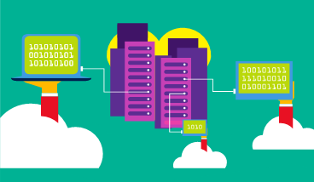
Public cloud
Owned by cloud services or hosting provider.
Provides resources and services to multiple organizations and users.
Accessed via secure network connection (typically over the internet).
Notes:
https://learn.microsoft.com/training/modules/describe-cloud-compute/5-define-cloud-models
What are public, private, and hybrid clouds? - https://azure.microsoft.com/resources/cloud-computing-dictionary/what-are-private-public-hybrid-clouds/

Slide 9
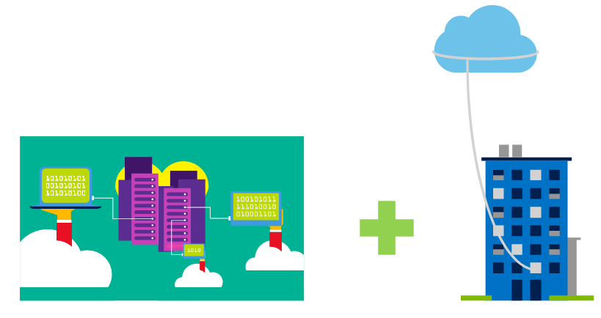
Hybrid cloud
Combines public and private clouds to allow applications to run in the most appropriate location.
Notes:
https://learn.microsoft.com/training/modules/describe-cloud-compute/5-define-cloud-models
Hybrid cloud models have the following characteristics:
Resource location. Specific resources are run or used in a public cloud―others are run or used in a private cloud.
Cost and efficiency. Hybrid cloud models allow an organization to leverage some of the benefits of cost, efficiency, and scale that are available with a public cloud model.
Control. Organizations retain management control in private clouds.
Skills. Technical skills are still required to maintain the private cloud and ensure both cloud models can operate together.

Slide 10
Cloud model comparison
Public cloud
Private cloud
Hybrid cloud
No capital expenditures to scale up.
Applications can be quickly provisioned and deprovisioned.
Organizations pay only for what they use.
Hardware must be purchased for start-up and maintenance.
Organizations have complete control over resources and security.
Organizations are responsible for hardware maintenance and updates.
Provides the most flexibility.
Organizations determine where to run their applications.
Organizations control security, compliance, or legal requirements.
Notes:
https://learn.microsoft.com/training/modules/describe-cloud-compute/5-define-cloud-models

Slide 11
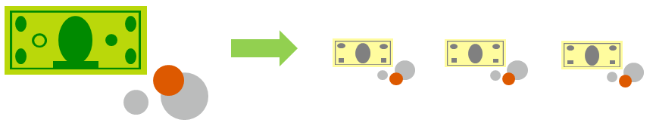
Compare CapEx vs. OpEx
Capital expenditure (CapEx)
Operational expenditure (OpEx)
The upfront spending of money on physical infrastructure.
Costs from CapEx have a value that reduces over time.
Spend on products and services as needed, pay-as-you-go.
Get billed immediately.
Notes:
https://learn.microsoft.com/training/modules/describe-cloud-compute/6-describe-consumption-based-model
Capital expenditure (CapEx)
Spend on physical infrastructure upfront.
Deduct the expense from your tax bill.
High upfront cost, but the value of your investment reduces over time.
Operational expenditure (OpEx)
Spend on services or products as needed.
Get billed immediately.
Deduct the expense from your tax bill in the same year.
No upfront cost, pay-as-you-use.

Slide 12
Consumption-based model
Cloud service providers operate on a consumption-based model, which means that end users only pay for the resources that they use.
Better cost prediction.
Prices for individual resources and services are provided.
Billing is based on actual usage.
Notes:
https://learn.microsoft.com/training/modules/describe-cloud-compute/6-describe-consumption-based-model
This consumption-based model brings with it many benefits, including:
No upfront costs.
No need to purchase and manage costly infrastructure that may or may not be used to its full extent.
The ability to pay for additional resources when they are needed.
The ability to stop paying for resources that are no longer needed.

Slide 13
Cloud benefits
Notes:
https://learn.microsoft.com/training/modules/describe-benefits-use-cloud-services/

Slide 14
Cloud benefits―objective domain
Describe the benefits of high availability and scalability in the cloud.
Describe the benefits of reliability and predictability in the cloud.
Describe the benefits of security and governance in the cloud.
Describe the benefits of manageability in the cloud.
Notes:
https://learn.microsoft.com/training/modules/describe-benefits-use-cloud-services/1-introduction

Slide 15
Cloud benefits
High availability
Elasticity
Scalability
Reliability
Predictability
Security
Governance
Manageability
Notes:
https://learn.microsoft.com/training/modules/describe-benefits-use-cloud-services/2-high-availability-scalability-cloud
https://learn.microsoft.com/training/modules/describe-benefits-use-cloud-services/3-reliability-predictability-cloud
https://learn.microsoft.com/training/modules/describe-benefits-use-cloud-services/4-security-governance-cloud
https://learn.microsoft.com/training/modules/describe-benefits-use-cloud-services/5-manageability-cloud

Slide 16
Cloud service types
Notes:
https://learn.microsoft.com/training/modules/describe-cloud-service-types

Slide 17
Cloud services―objective domain
Describe infrastructure as a service (IaaS).
Describe platform as a service (PaaS).
Describe software as a service (SaaS).
Describe the shared responsibility model.
Identify appropriate use cases for each cloud service (IaaS, PaaS, SaaS).
Notes:
https://learn.microsoft.com/training/modules/describe-cloud-service-types/1-introduction

Slide 18
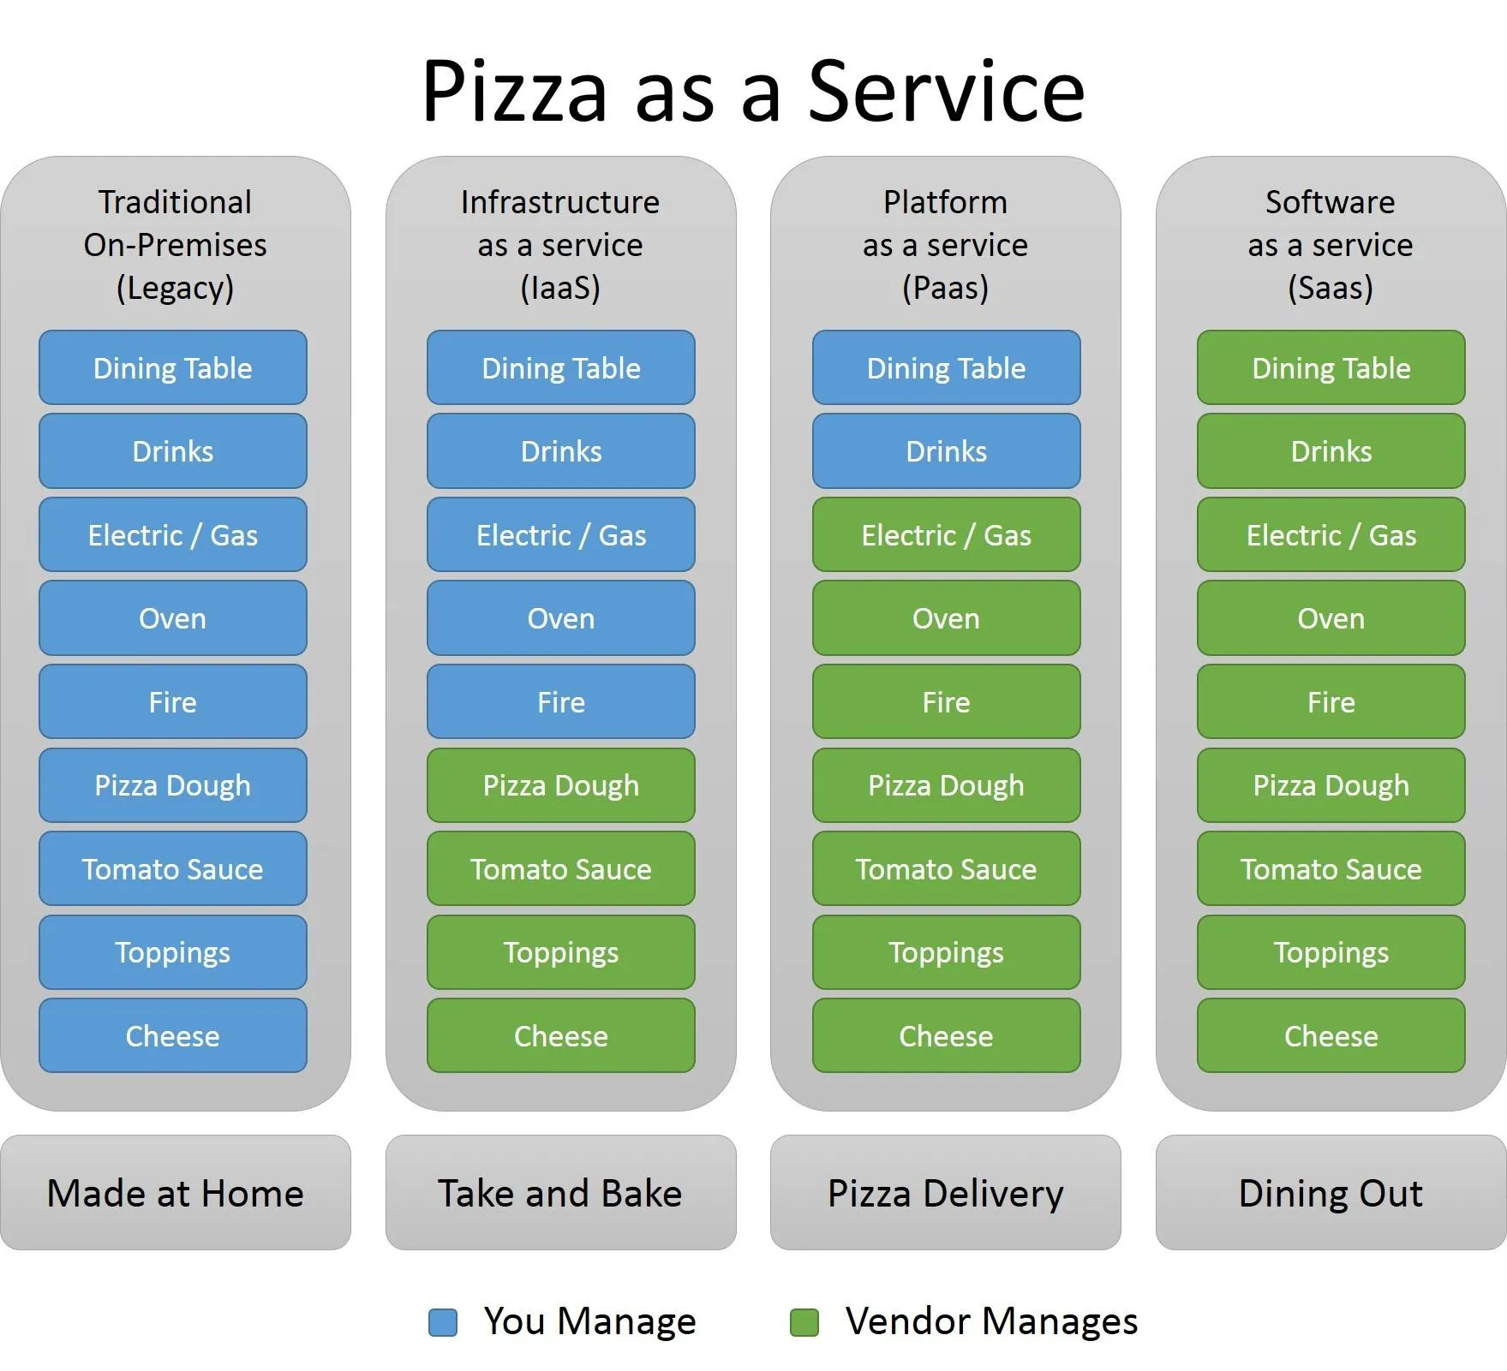


Slide 19
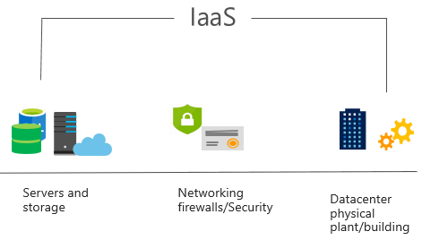
Infrastructure as a service (IaaS)
Build pay-as-you-go IT infrastructure by renting servers, virtual machines, storage, networks, and operating systems from a cloud provider.
Notes:
https://learn.microsoft.com/training/modules/describe-cloud-service-types/2-describe-infrastructure-service
For more information on IaaS, go to https://azure.microsoft.com/resources/cloud-computing-dictionary/what-is-iaas/
Most basic cloud computing services category.
Build pay-as-you-go IT infrastructure by renting servers, virtual machines, storage, networks, and operating systems from a cloud provider.
Instant computing infrastructure, provisioned and managed over the internet.

Slide 20
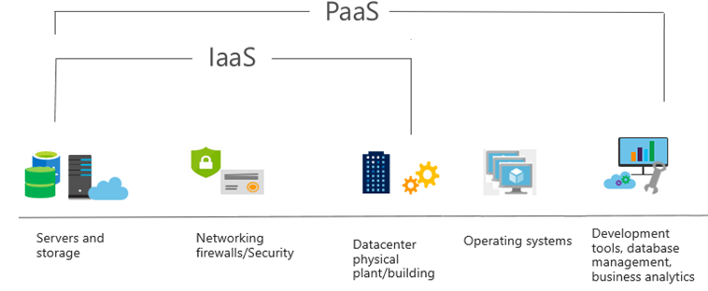
Platform as a service (PaaS)
Provides an environment for building, testing, and deploying software applications; without focusing on managing underlying infrastructure.
Notes:
https://learn.microsoft.com/training/modules/describe-cloud-service-types/3-describe-platform-service
For more information on PaaS, go to https://azure.microsoft.com/resources/cloud-computing-dictionary/what-is-paas/
Provides an environment for building, testing, and deploying software applications.
Helps create applications quickly, without focusing on managing underlying infrastructure.

Slide 21
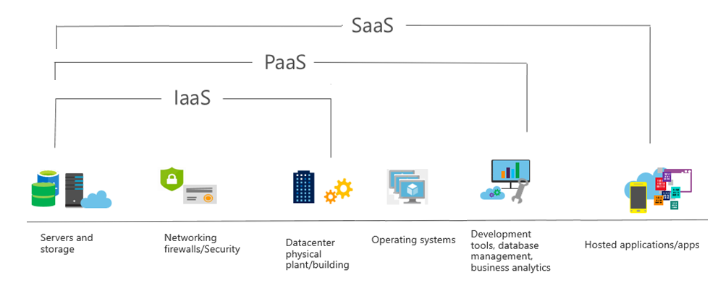
Software as a service (SaaS)
Users connect to and use cloud-based apps over the internet: for example, Microsoft Office 365, email, and calendars.
Notes:
https://learn.microsoft.com/training/modules/describe-cloud-service-types/4-describe-software-service
Common usage scenarios:
Examples of Microsoft SaaS services include Microsoft Office 365, Skype, and Microsoft Dynamics CRM Online.
For more information on SaaS, go to https://azure.microsoft.com/resources/cloud-computing-dictionary/what-is-saas/

Slide 22
Cloud service comparison
IaaS
PaaS
SaaS
The most flexible cloud service.
You configure and manage the hardware for your application.
Focus on application development.
Platform management is handled by the cloud provider.
Pay-as-you-go pricing model.
Users pay for the software they use on a subscription model.

Slide 23
Knowledge check
What is cloud computing?
Delivery of computing services over the internet.
Delivery of storage services over the internet.
Delivery of websites accessible via the internet.
Correct Answer: A
Cloud computing is the delivery of computing services over the internet.

Slide 24
Knowledge check
Which cloud model uses some datacenters focused on providing cloud services to anyone that wants them, and some data centers that are focused on a single customer?
Public cloud
Hybrid cloud
Private cloud
Correct Answer: B
The hybrid cloud model is a combination of public cloud and private cloud, using both datacenters dedicated solely to one customer and datacenters that are shared with the public.

Slide 25
Knowledge check
According to the shared responsibility model, which cloud service type places the most responsibility on the customer?
Infrastructure as a Service (IaaS)
Software as a Service (SaaS)
Platform as a Service (PaaS)
Correct Answer: A
IaaS places the most responsibility on the consumer, with the cloud provider being responsible for the basics of physical security, power, and connectivity.

Slide 26
Knowledge check
Which type of scaling involves adding or removing resources (such as virtual machines or containers) to meet demand?
Vertical scaling
Horizontal scaling
Direct scaling
Correct Answer: B
Horizontal scaling is adding or subtracting the number of resources.

Slide 27
Knowledge check
What is characterized as the ability of a system to recover from failures and continue to function?
Reliability
Predictability
Scalability
Correct Answer: A
Reliability is the ability of a system to recover from failures and continue to function, and it is one of the pillars of the Microsoft Azure Well-Architected Framework.

Slide 28
Azure architectural components
Notes:
https://learn.microsoft.com/training/modules/describe-core-architectural-components-of-azure/1-introduction

Slide 29
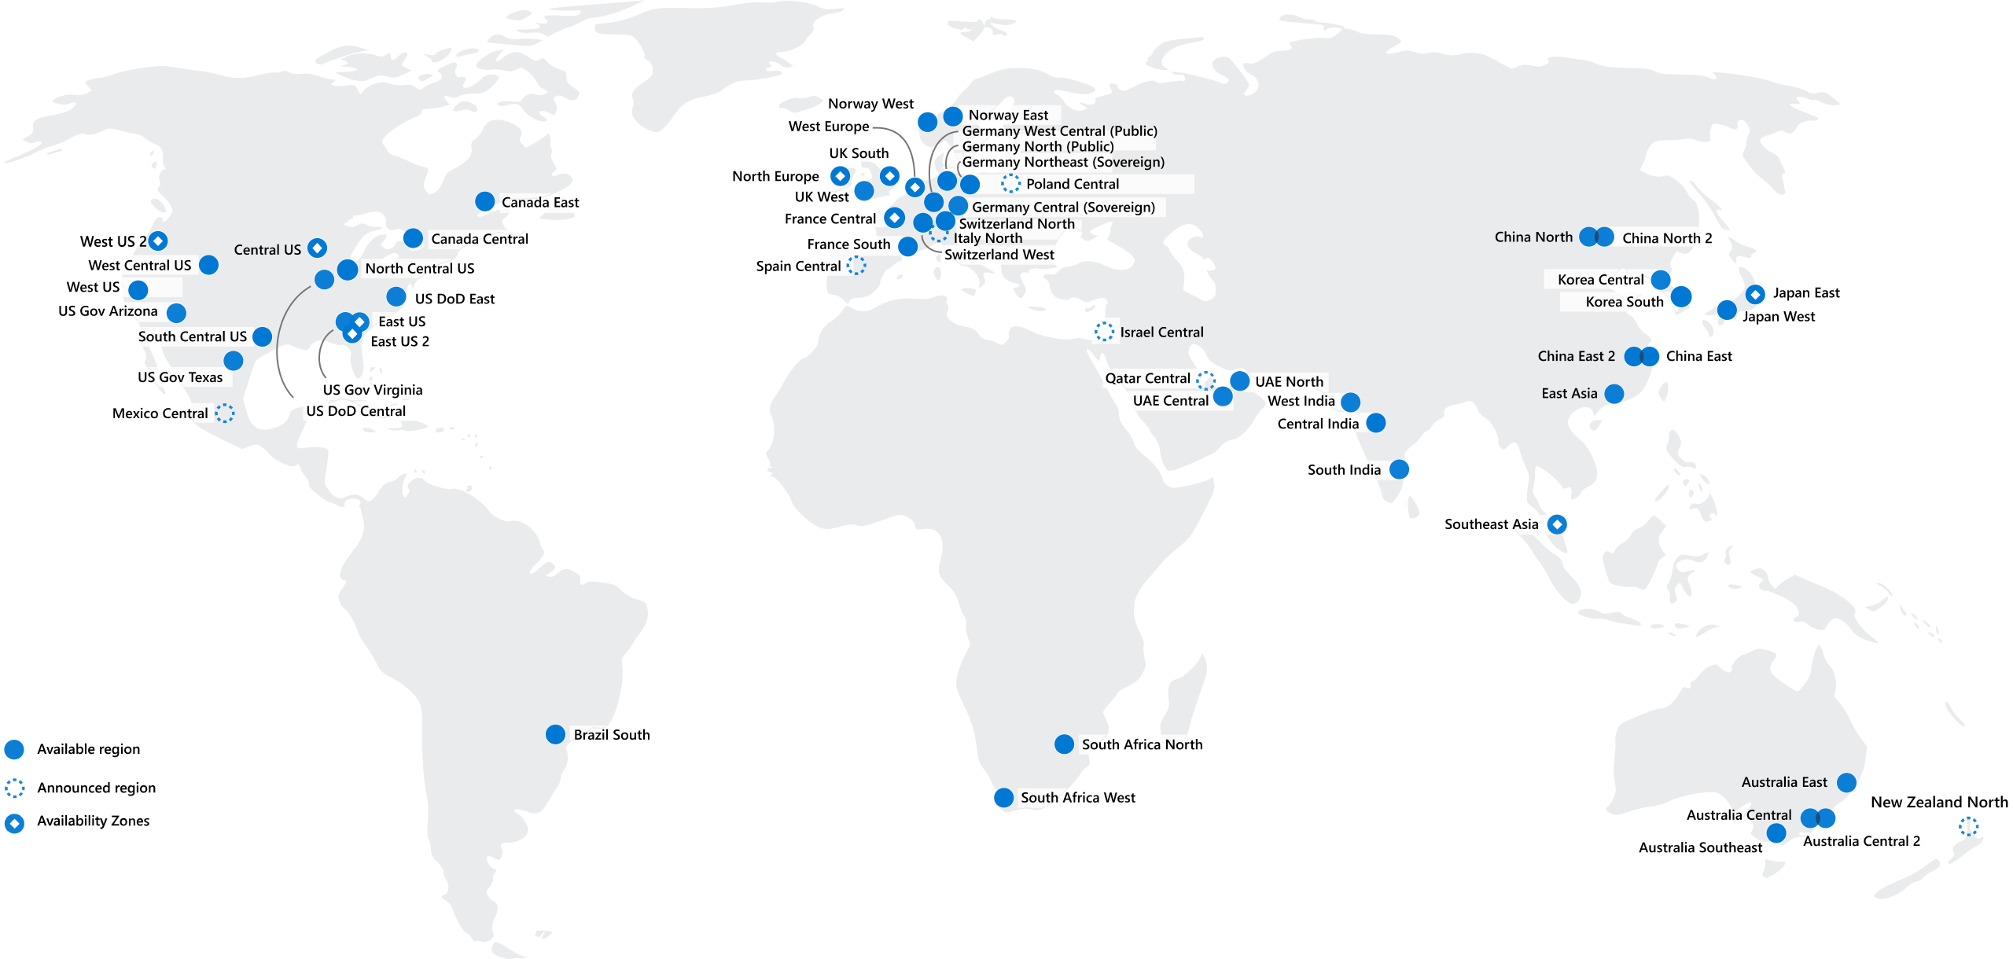
Regions
Azure offers more global regions than any other cloud provider with 60-plus regions representing over 140 countries
Regions are made up of one or more datacenters in close proximity.
They provide flexibility and scale to reduce customer latency.
Regions preserve data residency with a comprehensive compliance offering.
Notes:
https://learn.microsoft.com/training/modules/describe-core-architectural-components-of-azure/5-describe-azure-physical-infrastructure
A region represents a collection of datacenters.
They provide flexibility and scale.
Regions preserve data residency.
You can select regions close to your users.
Be aware of region deployment availability.
There are global services that are region independent.
A list of regions and their locations is available at https://azure.microsoft.com/explore/global-infrastructure/data-residency/#overview

Slide 30
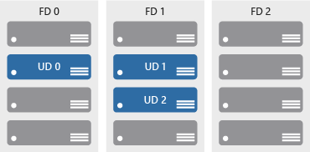

Availability zones
Provide protection against downtime due to datacenter failure.
Physically separate datacenters within the same region.
Each datacenter is equipped with independent power, cooling, and networking.
Connected through private fiber-optic networks.
Azure Region
Availability Zone 1
Availability Zone 2
Availability Zone 3
Notes:
https://learn.microsoft.com/training/modules/describe-core-architectural-components-of-azure/5-describe-azure-physical-infrastructure
Physically separate locations within an Azure region.
Takes availability sets to the next level
Includes one or more datacenters, equipped with independent power, cooling, and networking.
Acts as an isolation boundary.
If one availability zone goes down, the other continues working.
More details about Availability Zones in Azure are available at https://learn.microsoft.com/azure/reliability/availability-zones-overview
https://www.youtube.com/watch?v=qNYf2Ox75gQ

Slide 31
Region pairs
At least 300 miles of separation between region pairs.
Automatic replication for some services.
Prioritized region recovery in the event of outage.
Updates are rolled out sequentially to minimize downtime.
Web link: https://aka.ms/PairedRegions
Region
North Central US​
East US​
West US 2​
US East 2​
Canada Central​
North Europe​
UK West​
Germany Central​
South East Asia​
East China​
Japan East​
Australia Southeast​
India South​
Brazil South (Primary)​
Region
South Central US​
West US​
West Central US​
Central US​
Canada East​
West Europe​
UK South​
Germany Northeast​
East Asia​
North China​
Japan West​
Australia East​
India Central​
South Central US ​
Notes:
https://learn.microsoft.com/training/modules/describe-core-architectural-components-of-azure/5-describe-azure-physical-infrastructure
Each Azure region is paired with another region.
Azure prefers at least 300 miles of separation between datacenters in a regional pair.
Some services provide automatic replication to the paired region.
In an outage, recovery of one region is prioritized out of every pair.
Azure system updates are rolled out to paired regions sequentially (not at the same time).
For a list of geographies, regions, region-pairs, and other details, go to https://azure.microsoft.com/explore/global-infrastructure/geographies/#overview
For a full list of region pairs, go to https://learn.microsoft.com/azure/reliability/cross-region-replication-azure#what-are-paired-regions

Slide 32






Azure resources
Azure resources are components like storage, virtual machines, and networks that are available to build cloud solutions.
Virtual machines
Storage accounts
Virtual networks
App services
SQL databases
Functions
Notes:
https://learn.microsoft.com/training/modules/describe-core-architectural-components-of-azure/6-describe-azure-management-infrastructure

Slide 33



Resource groups
A resource group is a container you use to manage and aggregate resources in a single unit.
Resources can exist in only one resource group.
Resources can exist in different regions.
Resources can be moved to different resource groups.
Applications can utilize multiple resource groups.
Resource groups (web plus DB, VM, storage) in one group
OR
Web and DB resource group
Virtual machine resource group
Storage resource group
Notes:
https://learn.microsoft.com/training/modules/describe-core-architectural-components-of-azure/6-describe-azure-management-infrastructure
Containers for multiple resources that share the same life cycle.
Aggregates resources into a single manageable unit.
Every Azure resource must exist in one (and only one) resource group.
Secure at the resource group (or resource) level―using role-based access control (RBAC).

Slide 34
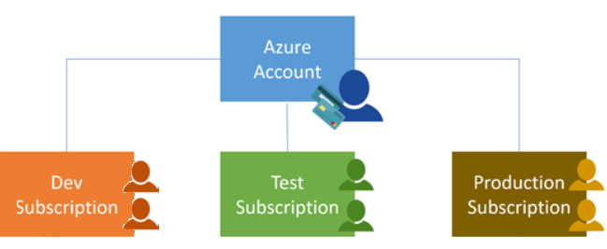
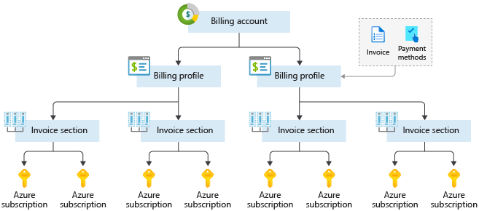
Azure subscriptions
An Azure subscription provides you with authenticated and authorized access to Azure accounts.
Billing boundary: Generate separate billing reports and invoices for each subscription.
Access control boundary: Manage and control access to the resources that users can provision with specific subscriptions.
Notes:
https://learn.microsoft.com/training/modules/describe-core-architectural-components-of-azure/6-describe-azure-management-infrastructure
An account can have one or multiple subscriptions.
Azure subscription offers: https://azure.microsoft.com/en-us/support/legal/offer-details/

Slide 35
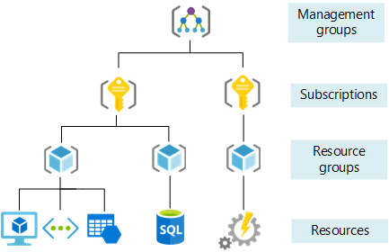
Management groups
Management groups can include multiple Azure subscriptions.
Subscriptions inherit conditions applied to the management group.
10,000 management groups can be supported in a single directory.
A management group tree can support up to six levels of depth.
Notes:
https://learn.microsoft.com/training/modules/describe-core-architectural-components-of-azure/6-describe-azure-management-infrastructure
Management groups can include multiple Azure subscriptions.
Subscriptions inherit conditions applied to the management group.
10,000 management groups can be supported in a single directory.
A management group tree can support up to six levels of depth.
Management groups: https://learn.microsoft.com/azure/governance/management-groups/

Slide 36
Knowledge check
How many resource groups can a resource be in at the same time?
One
Two
Three
Correct Answer: A
A resource can only be in one group at a time.

Slide 37
Knowledge check
What happens to the resources within a resource group when an action or setting at the Resource Group level is applied?
Current resources inherit the setting, but future resources don't.
Future resources inherit the setting, but current ones don't.
The setting is applied to current and future resources.
Correct Answer: C
Resources inherit permissions from their resource group.

Slide 38
Knowledge check
What Azure feature replicates resources across regions that are at least 300 miles away from each other?
Region pairs
Availability Zones
Sovereign regions
Correct Answer: A
Most Azure regions are paired with another region within the same geography (such as US, Europe, or Asia) at least 300 miles away.

Slide 39
Labs https://github.com/nanddeepn/AzureLabs
Notes:
https://learn.microsoft.com/training/modules/describe-core-architectural-components-of-azure/1-introduction
https://github.com/ddneves/awesome-azure-learning/blob/master/topics/certifications/az-900.md#labs
https://github.com/kingdomb/AZ-900T0x-Practical_Labs-AzureFundamentals/tree/master/Instructions/Walkthroughs

Slide 40
Microsoft Azure Free Account
Where to start?
https://azure.microsoft.com/free
What’s included in the free tier account?
12 months of popular free services
$200 credit to use in the first 30 days
25+ Azure services that are always free
Let’s create our account !

